Slide 1
Chapter 14
Big Data Analytics and NoSQL

Slide 2
Learning Objectives
In this chapter, you will learn:
What Big Data is and why it is important in modern business
The primary characteristics of Big Data and how these go beyond the traditional “3 Vs”
How the core components of the Hadoop framework, HDFs and MapReduce operate
What the major components of the Hadoop ecosystems are

Slide 3
Learning Objectives
In this chapter, you will learn:
The four major approaches of the NoSQL data model and how the differ from the relational model
About data analytics, including data mining and predictive analytics

Slide 4
Big Data
Volume: Quantity of data to be stored
Scaling up is keeping the same number of systems but migrating each one to a larger system
Scaling out means when the workload exceeds server capacity, it is spread out across a number of servers
Velocity: Speed at which data is entered into system and must be processed
Stream processing focuses on input processing and requires analysis of data stream as it enters the system
Feedback loop processing refers to the analysis of data to produce actionable results

Slide 5
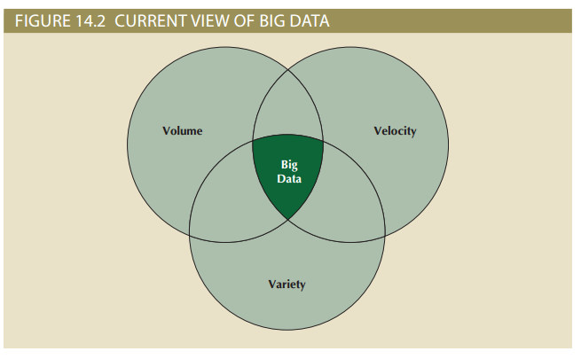
Figure 14.2 – Current View of Big Data

Slide 6
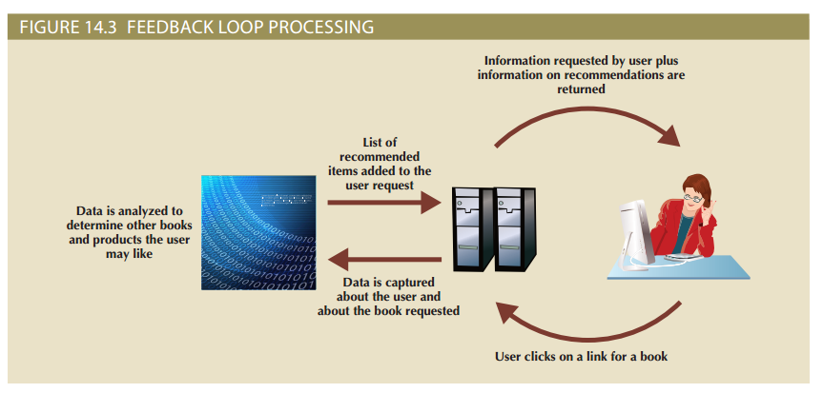
Figure 14.3 – Feedback Loop Processing

Slide 7
Big Data
Variety: Variations in the structure of data to be stored
Structured data fits into a predefined data model
Unstructured data dies not fit into a predefined model
Other characteristics:
Variability: Changes in meaning of data based on context
Sentimental analysis attempts to determine attitude
Veracity: Trustworthiness of data
Value: Degree data can be analyzed for meaningful insight
Visualization: Ability to graphically resent data to make it understandable to users

Slide 8
Big Data
Characteristics important in working with data in relational models are universal and also apply to Big Data
Relational databases not necessarily best for storing and managing all organizational data
Polyglot persistence: Coexistence of a variety of data storage and management technologies within an organization’s infrastructure

Slide 9
Hadoop
De facto standard for most Big Data storage and processing
Java-based framework for distributing and processing very large data sets across clusters of computers
Most important components:
Hadoop Distributed File System (HDFS): Low-level distributed file processing system that can be used directly for data storage
MapReduce: Programming model that supports processing large data sets

Slide 10
Hadoop Distributed File System (HDFS)
Approach based on several key assumptions:
High volume - Default block sizes is 64 MB and can be configured to even larger values
Write-once, read-many - Model simplifies concurrent issues and improves data throughput
Streaming access - Hadoop is optimized for batch processing of entire files as a continuous stream of data
Fault tolerance – HDFS is designed to replicate data across many different devices so that when one fails, data is still available from another device

Slide 11
Hadoop Distributed File System (HDFS)
Uses several types of nodes (computers):
Data node store the actual file data
Name node contains file system metadata
Client node makes requests to the file system as needed to support user applications
Data node communicates with name node by regularly sending block reports and heartbeats

Slide 12
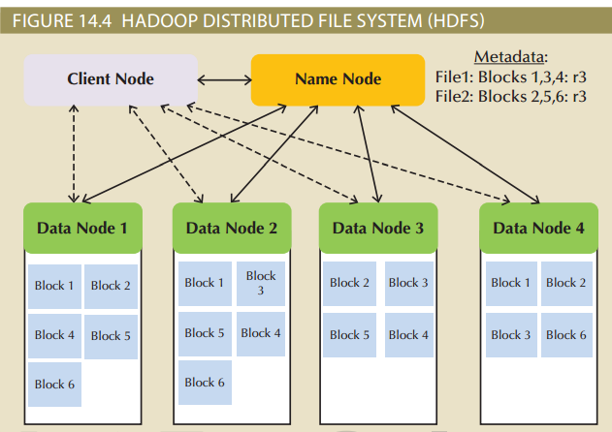
Figure 14.4 – Hadoop Distributed File System (HDFS)

Slide 13
MapReduce
Framework used to process large data sets across clusters
Breaks down complex tasks into smaller subtasks, performing the subtasks and producing a final result
Map function takes a collection of data and sorts and filters it into a set of key-value pairs
Mapper program performs the map function
Reduce summaries results of map function to produce a single result
Reducer program performs the reduce function

Slide 14
MapReduce
Implementation complements HDFS structure
Uses a job tracker or central control program to accept, distribute, monitor and report on jobs in a Hadoop environment
Task tracker is a program in MapReduce responsible for reducing tasks on a node
System uses batch processing which runs tasks from beginning to end with no user interaction

Slide 15
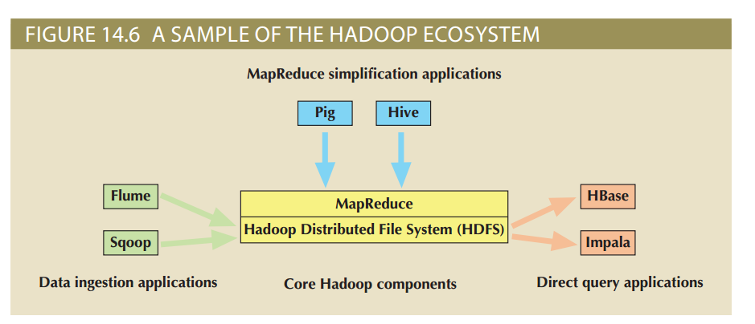
Figure 14.6 – A Sample of the Hadoop Ecosystem

Slide 16
Hadoop Ecosystem
Map Reduce Simplification Applications:
Hive is a data warehousing system that sites on top of HDFS and supports its own SQL-like language
Pig compiles a high-level scripting language (Pig Latin) into MapReduce jobs for executing in Hadoop
Data Ingestion Applications:
Flume is a component for ingesting data in Hadoop
Sqoop is a tool for converting data back and forth between a relational database and the HDFS

Slide 17
Hadoop Ecosystem
Direct Query Applications:
HBase is a column-oriented NoSQL database designed to sit on top of the HDFS that quickly processes sparse datasets
Impala was the first SQL-on-Hadoop application

Slide 18
NoSQL
Name given to non-relational database technologies developed to address Big Data challenges
Key-value (KV) databases store data as a collection of key-value pairs organized as buckets which are the equivalent of tables
Document databases store data in key-value pairs in which the value components are tag-encoded documents grouped into logical groups called collections

Slide 19
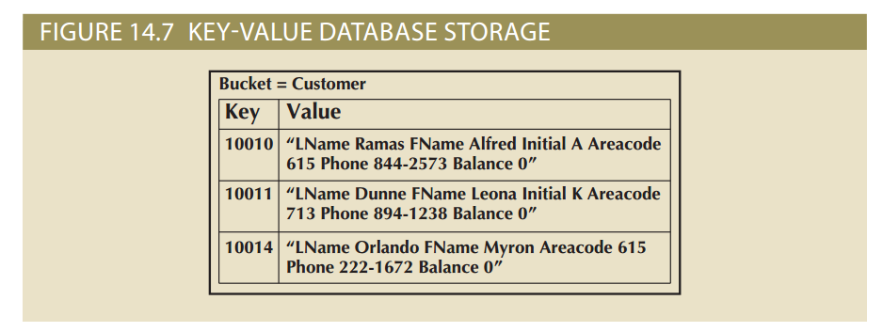
Figure 14.7- Key-Value Database Storage

Slide 20
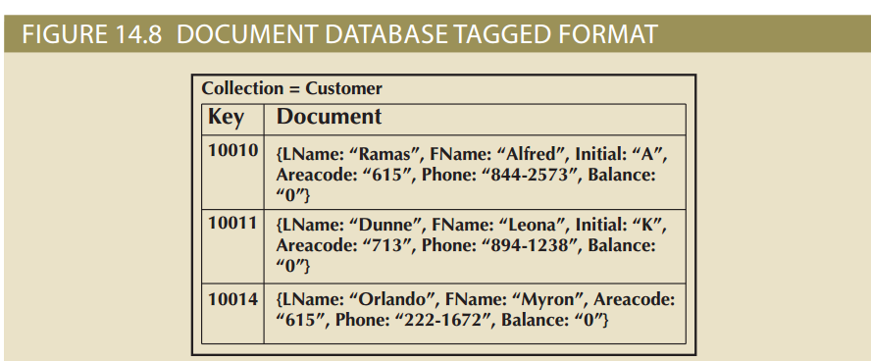
Figure 14.8- Document Database Tagged Format

Slide 21
NoSQL
Column-oriented databases refers to two technologies:
Column-centric storage: Data stored in blocks which hold data from a single column across many rows
Row-centric storage: Data stored in block which hold data from all columns of a given set of rows
Graph databases store data on relationship-rich data as a collection of nodes and edges
Properties are the attributes of a node or edge of interest to a user
Traversal is a query in a graph database

Slide 22
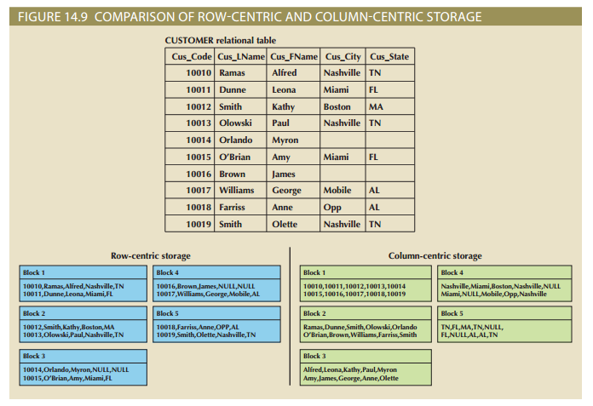
Figure 14.9- Comparison of Row-Centric and Column-Centric Storage

Slide 23
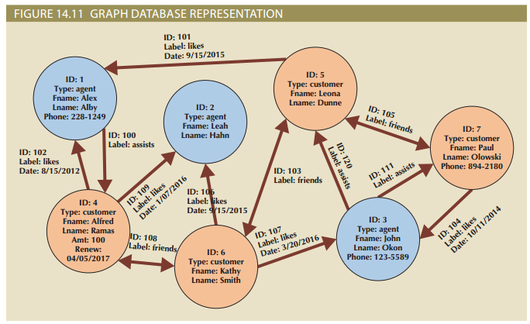
Figure 14.10- Graph Database Representation

Slide 24
NewSQL Databases
Database model that attempts to provide ACID-compliant transactions across a highly distributed infrastructure
Latest technologies to appear in the data management area to address Big Data problems
No proven track record
Have been adopted by relatively few organizations

Slide 25
Data Analytics
Subset of business intelligence (BI) functionality that encompasses mathematical, statistical, and modeling techniques used to extract knowledge from data
Continuous spectrum of knowledge acquisition that goes from discovery to explanation to prediction
Explanatory analytics focuses on discovering and explaining data characteristics based on existing data
Predictive analytics focuses on predicting future data outcomes with a high degree of accuracy

Slide 26
Data Mining
Focuses on the discovery and explanation stages of knowledge acquisition by:
Analyzing massive amounts of data to uncover hidden trends, patterns, and relationships
Forming computer models to simulate and explain findings and using them to support decision making
Can be run in two modes:
Guided – End-user decides techniques to apply to data
Automated – End-user sets up the tool to run automatically and the data-mining tool applies multiple techniques to find significant relationships

Slide 27
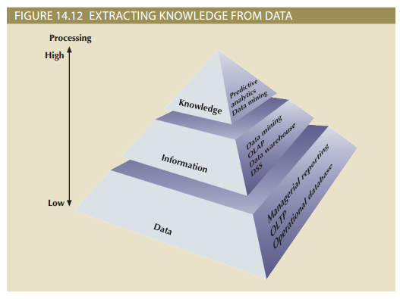
Figure 14.12- Extracting Knowledge From Data

Slide 28
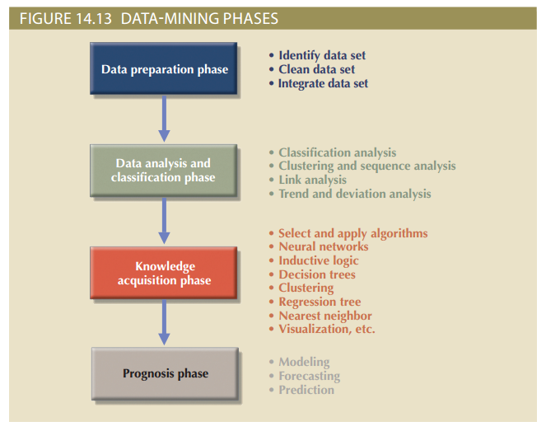
Figure 14.13- Data-Mining Phases

Slide 29
Predictive Analytics
Refers to the use of advanced mathematical, statistical, and modeling tools to predict future business outcomes with a high degree of accuracy
Focuses on creating actionable models to predict future behaviors and events
Most BI vendors are dropping the term data mining and replacing it with predictive analytics
Models used in customer service, fraud detection, targeted marketing and optimized pricing
Can add value in many different ways but needs to be monitored and evaluated to determine return on investment

